Slide 1

基于MindSpore的Falcon大模型迁移与性能研究
Migration Progress(stage 1)
Week 7
曾子瑄
2023.12.07
Notes:
照片为学生拍摄的礼堂

Slide 2
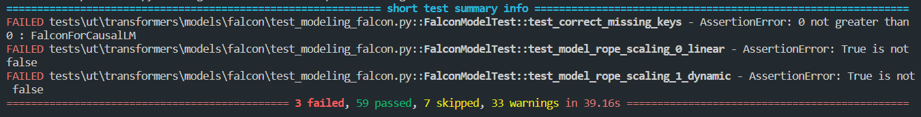
Unit tests

Slide 3
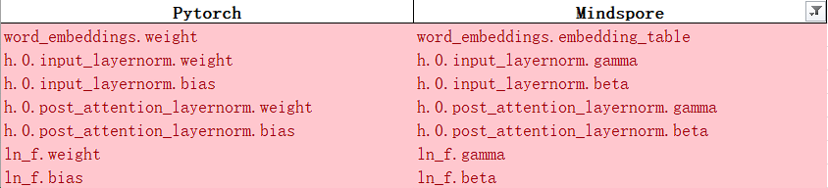
Pretrained param alignment
Only support Acend device currently

Slide 4
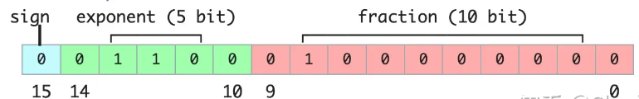
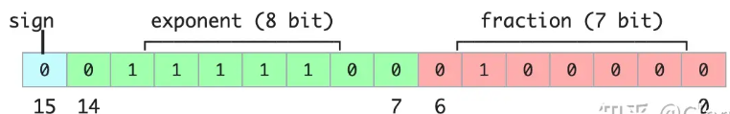
Precision
FP16
BF16
FP32

Slide 5
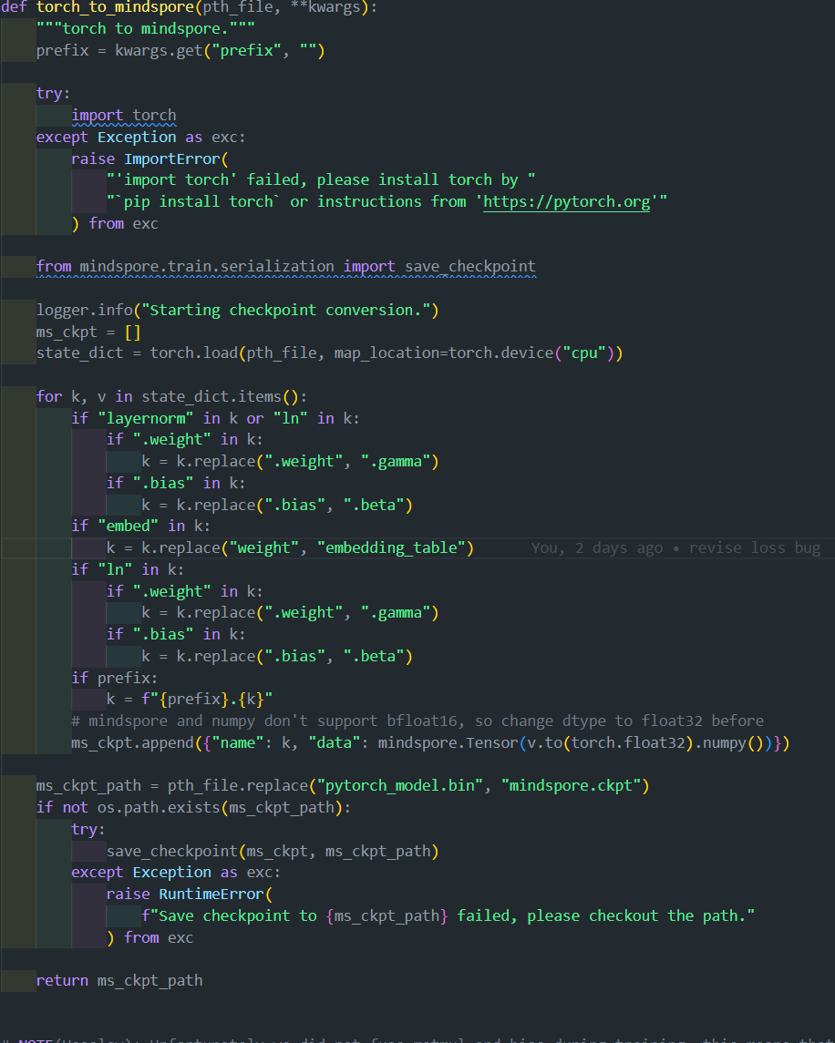
weight mapping

Slide 6
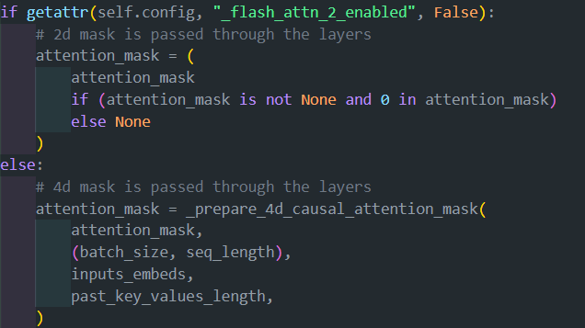
Some error

Slide 7


